Slide 1
Registering Office 365 Audit Log Webhook
Foo Shen Wu (Microsoft)
Sydney, Australia

Slide 2
Overall
Turn on Unified logging in Office 365.
Register Azure AD app to associate permissions to the Graph API
Create Power Automate cloud flows to subscribe, receive and unsubscribe

Slide 3
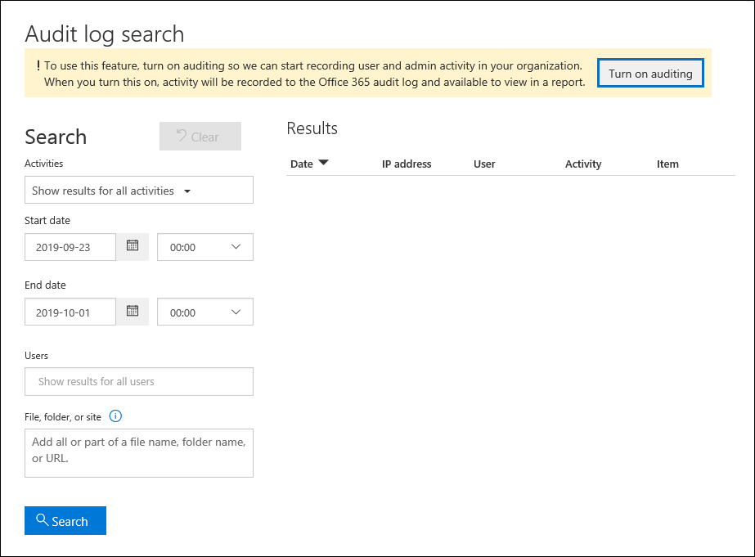
Turn on auditing

Slide 4
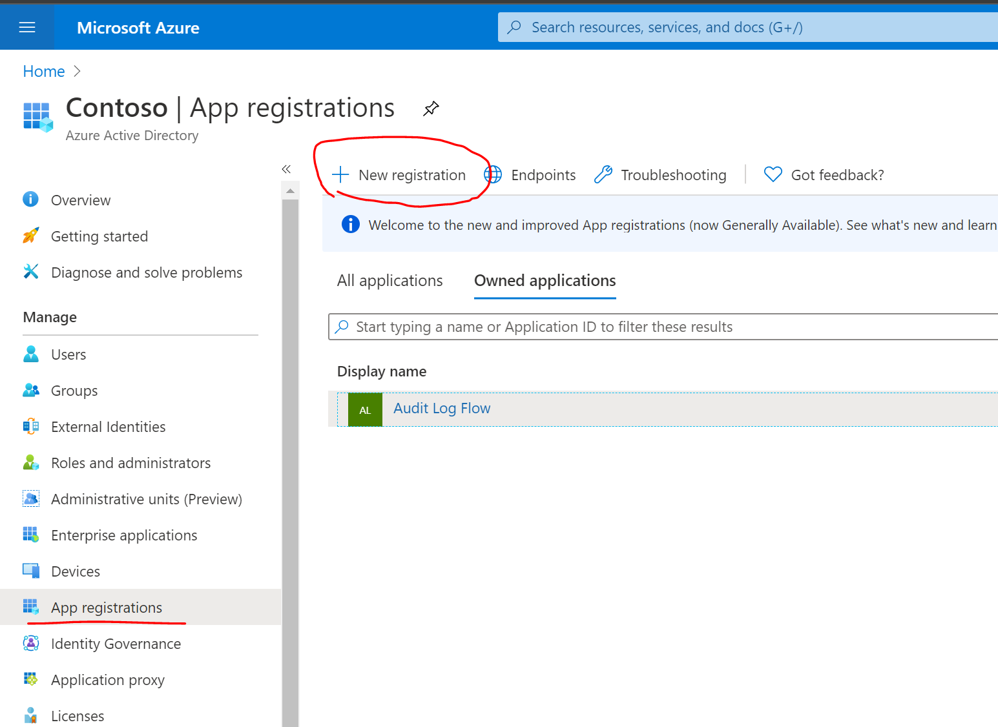
Register Azure AD App
1

Slide 5
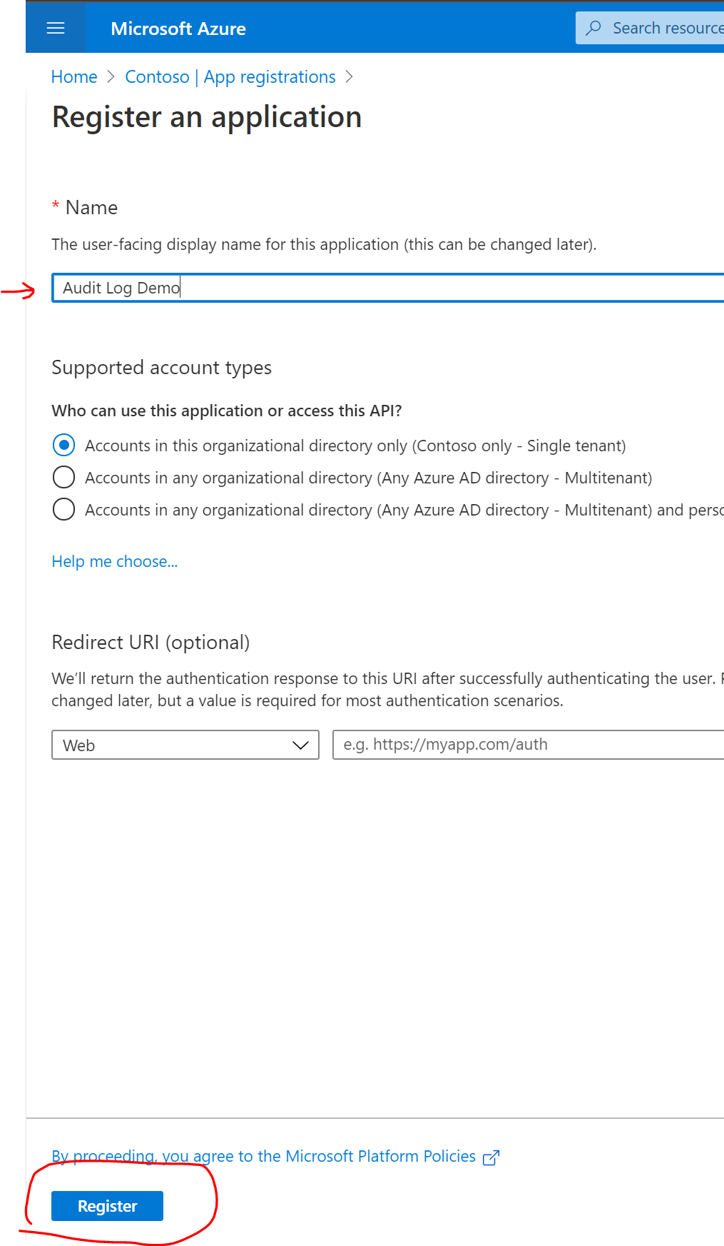
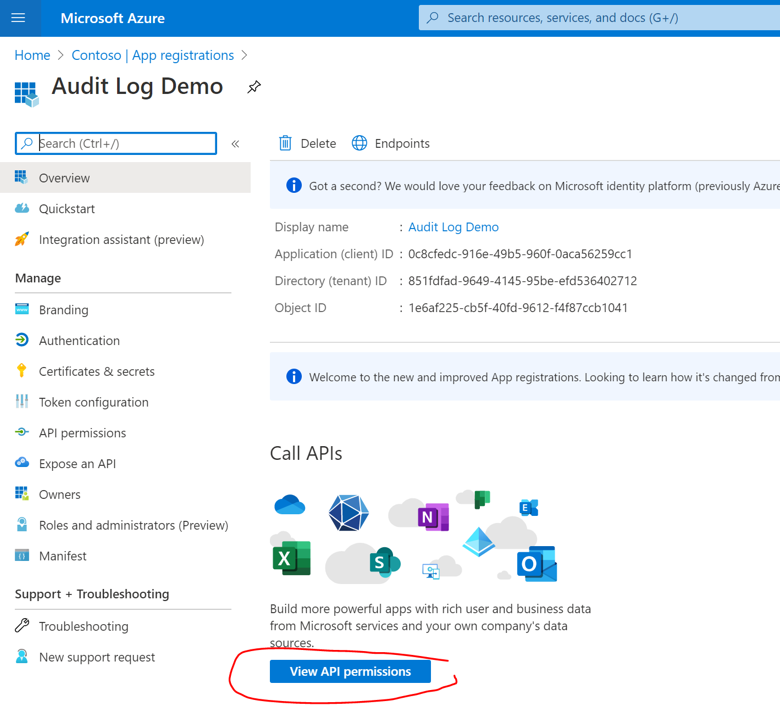
2
3

Slide 6
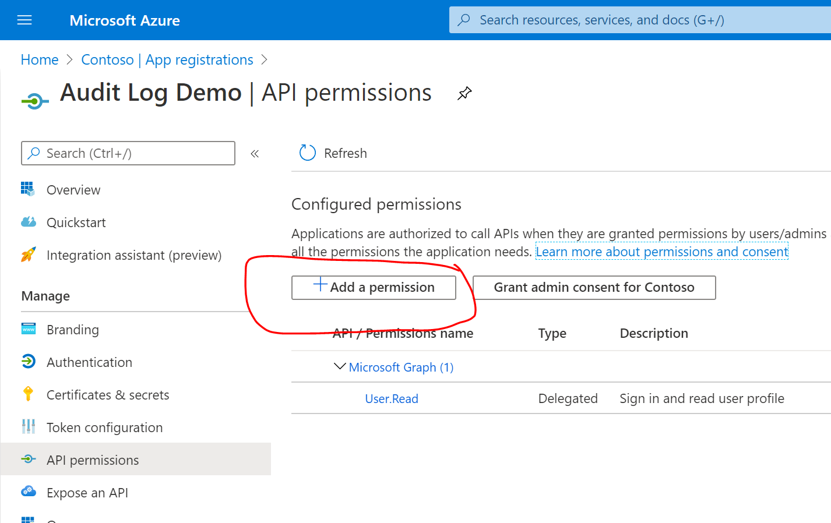
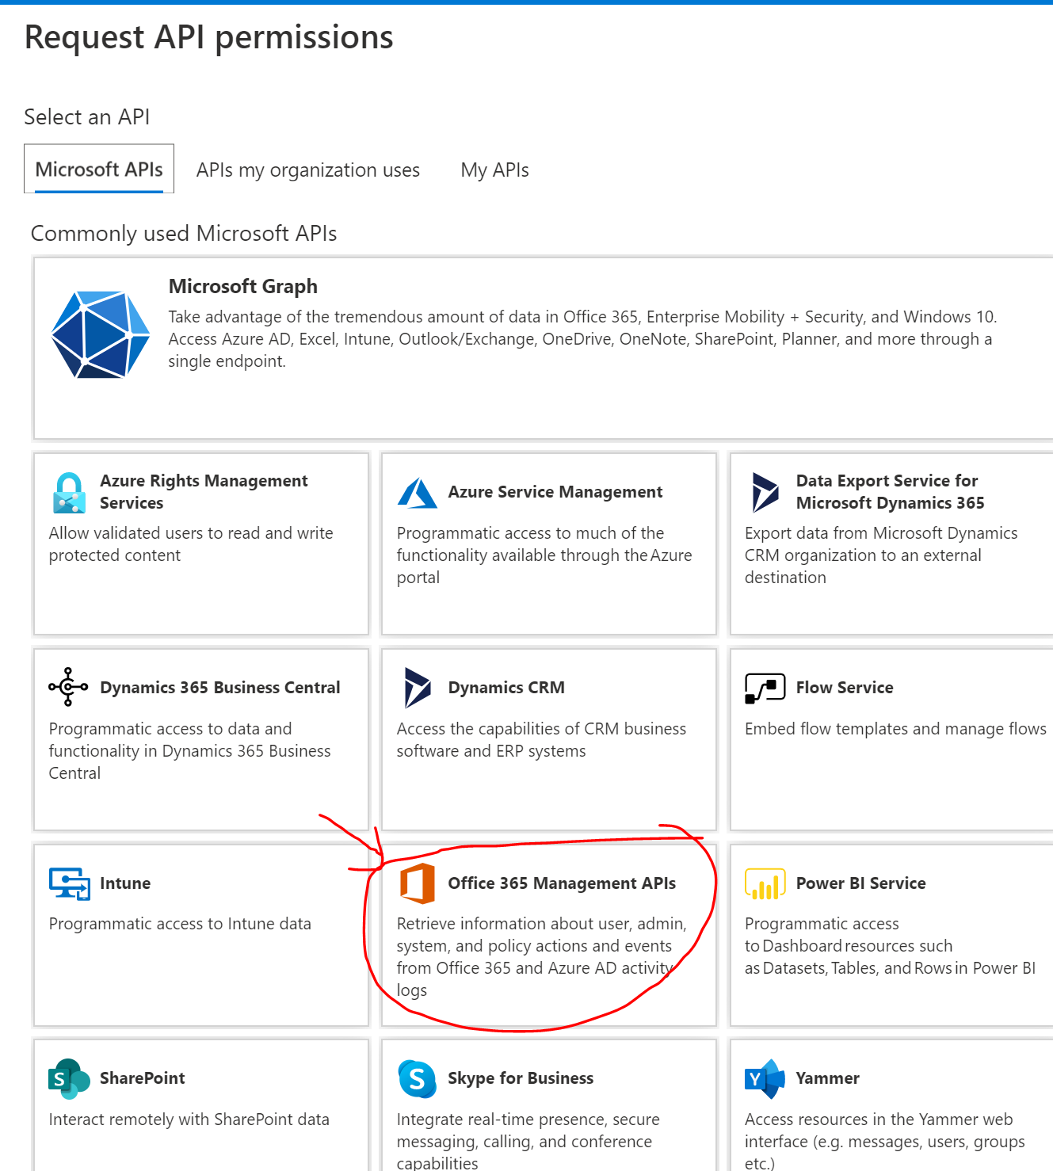
4
5

Slide 7
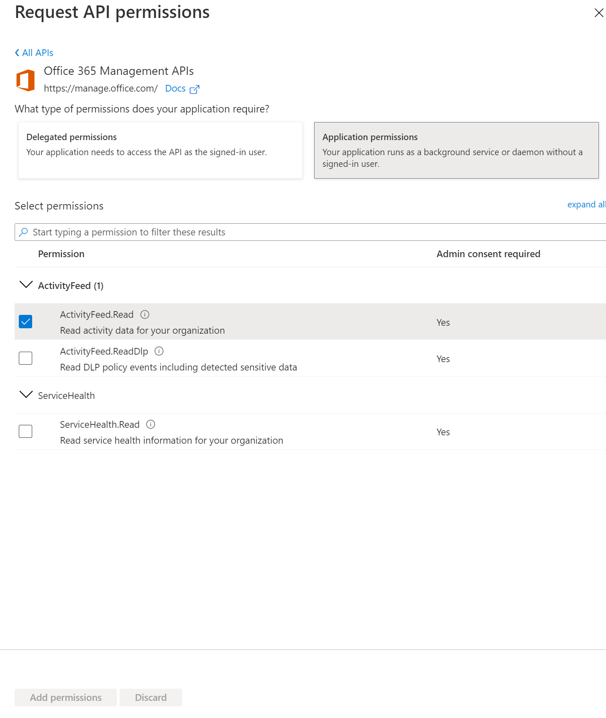
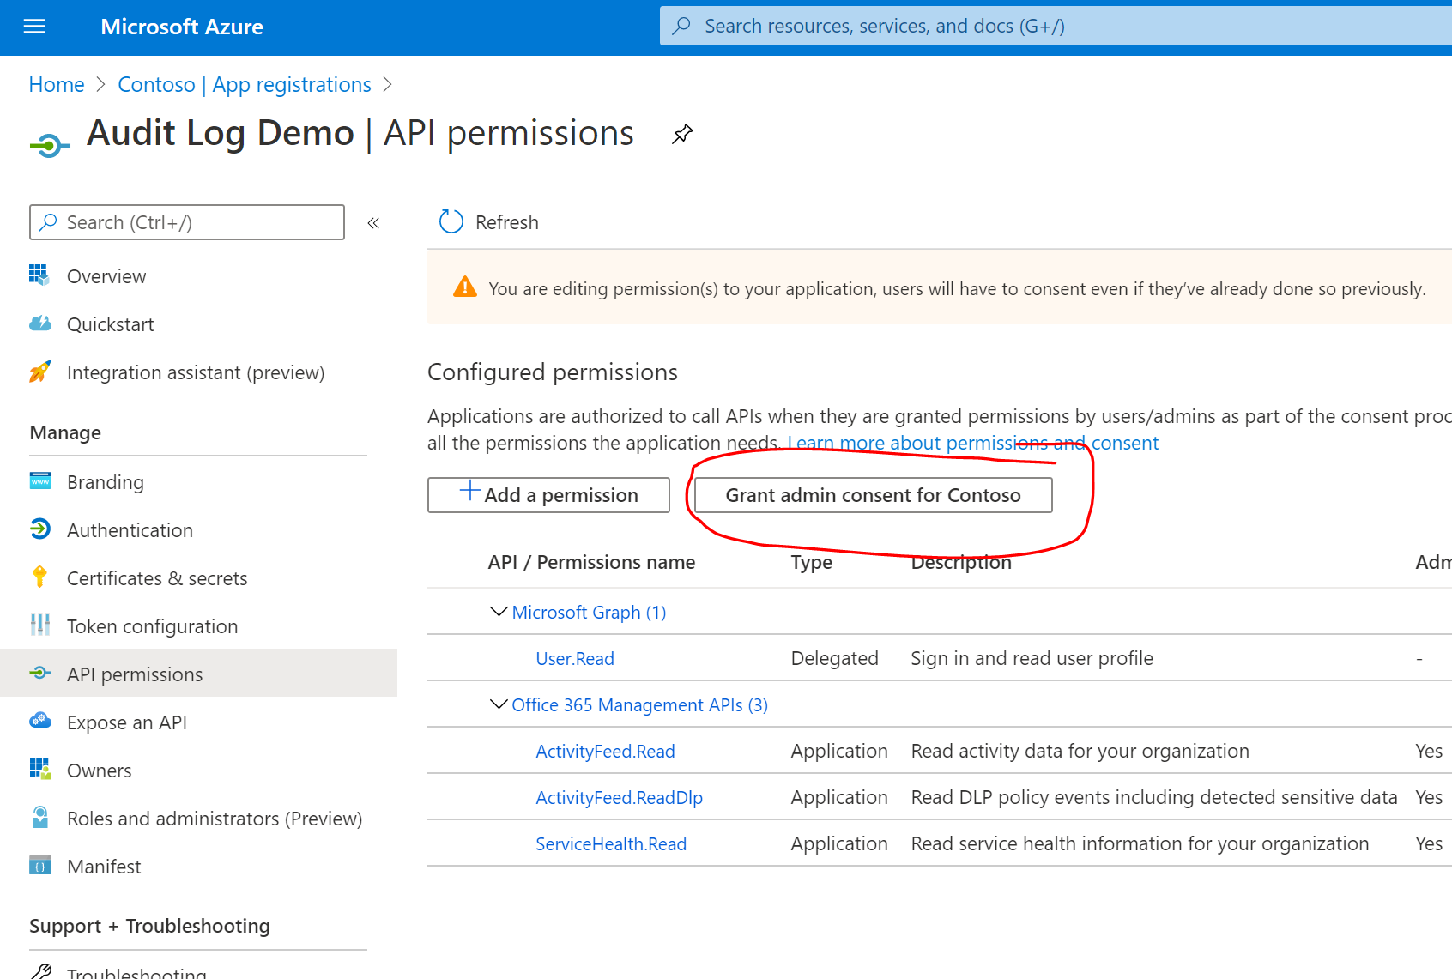
6
7

Slide 8
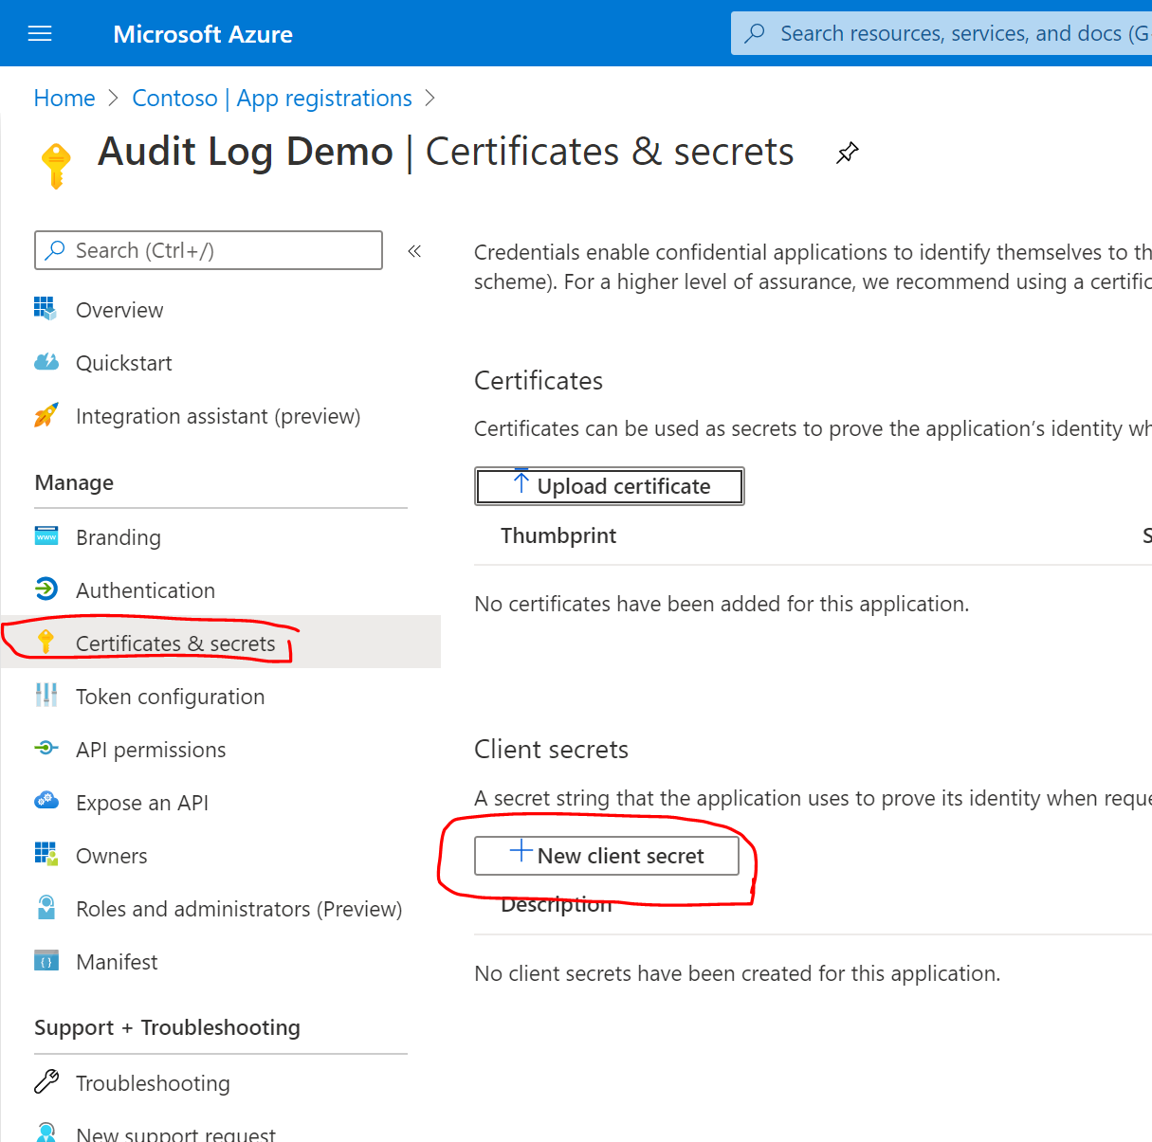
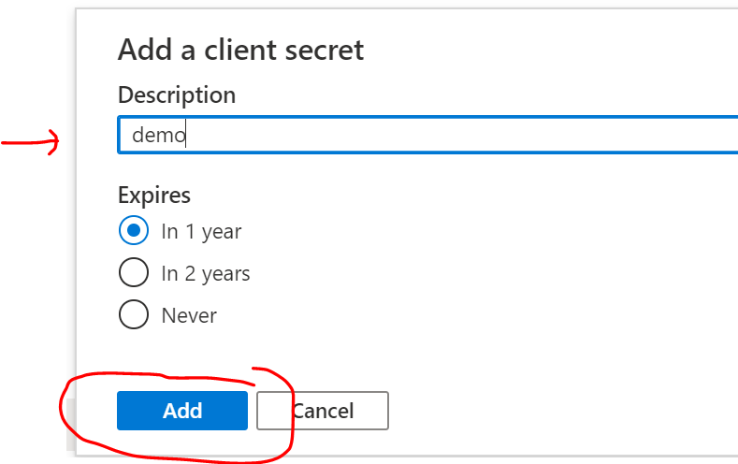
8
9

Slide 9
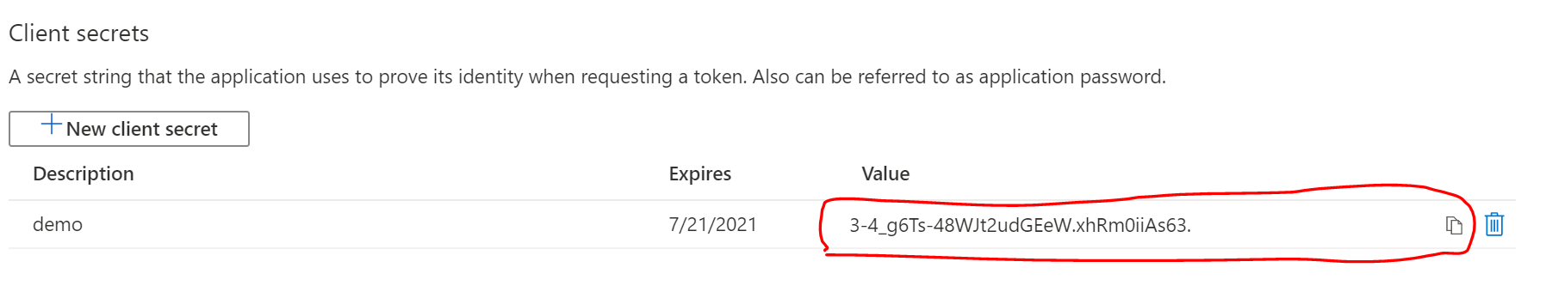
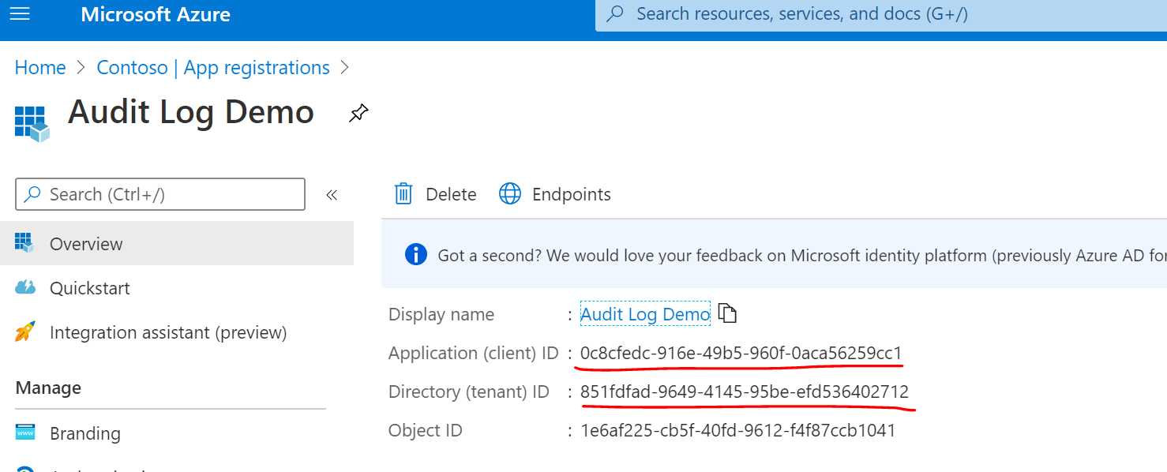
Important: the client secret key is not visible anymore after you have navigated away from this page.
You can copy and save it in a safe place. You can also create new keys if you lost one.
Click on Overview and copy the Client ID and Tenant ID as well.

Slide 10
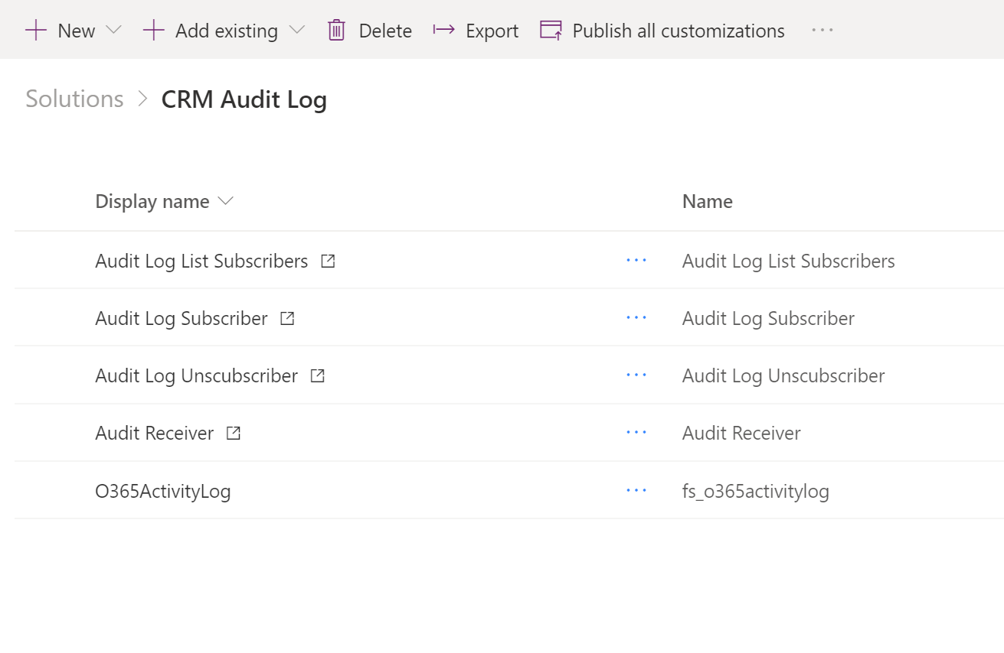
Power Automate solution
Run this to check on any existing subscription
Run this one time to register webhook to the audit log
Run this to unregister the webhook. No need to run this if need to temporarily pause the webhook – simply turn off the receiver flow.
This is the receiver of the webhook. This is where the processing happens.
This is the entity to store the audit log details.

Slide 11
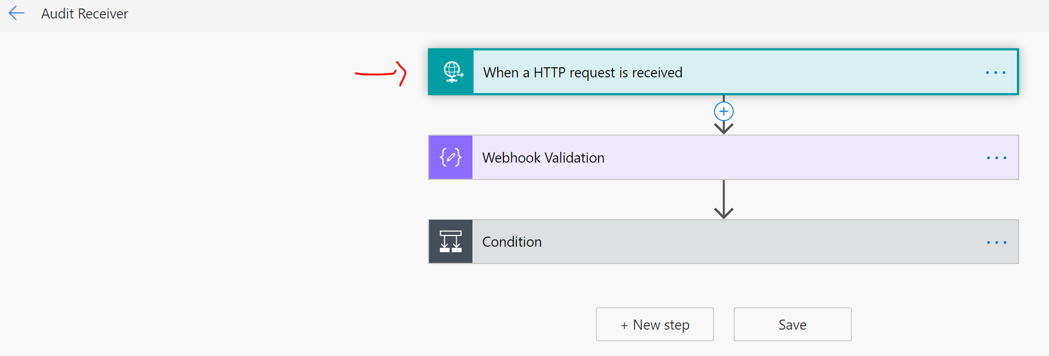
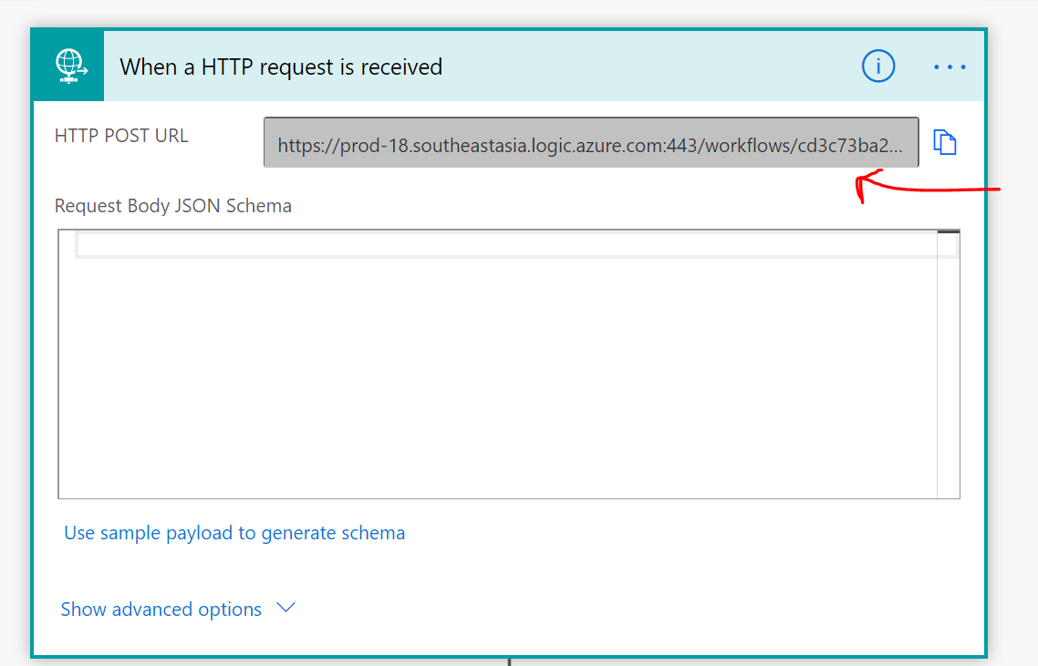
Generate new webhook end point
After importing the solution, edit the Audit Receiver flow and recreate the HTTPS end point by removing the HTTP Request trigger, and then re-add the trigger into it. It will generate a HTTPS end point automatically upon save. Copy this URL.

Slide 12
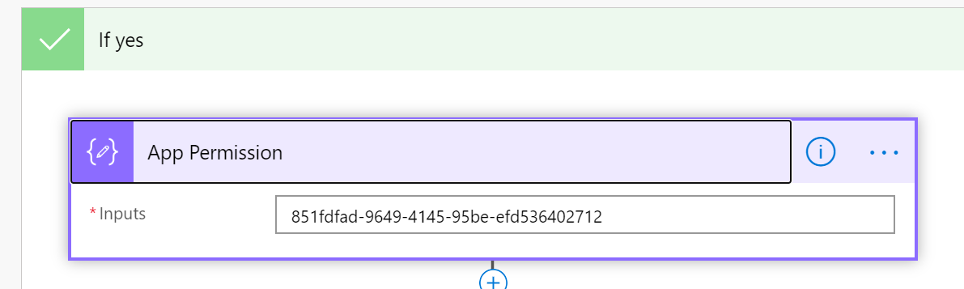
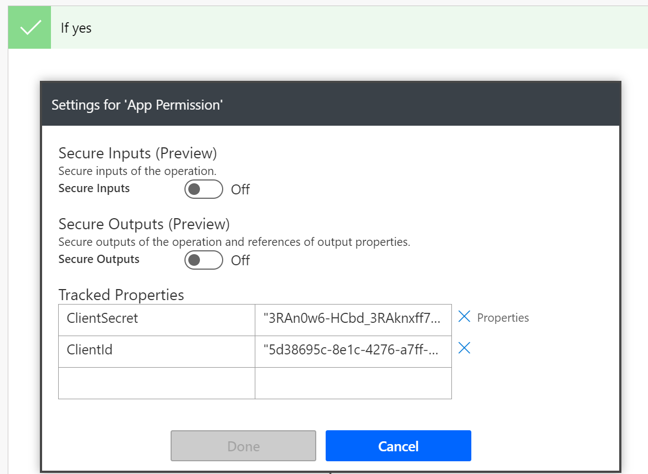
Expand the App Permission action and paste your Tenant ID value into the Input here.
In the same action, click on (…) then Settings. Replace the ClientSecret and ClientId values in TrackedProperties with the ones generated in Azure AD App registration steps.

Slide 13
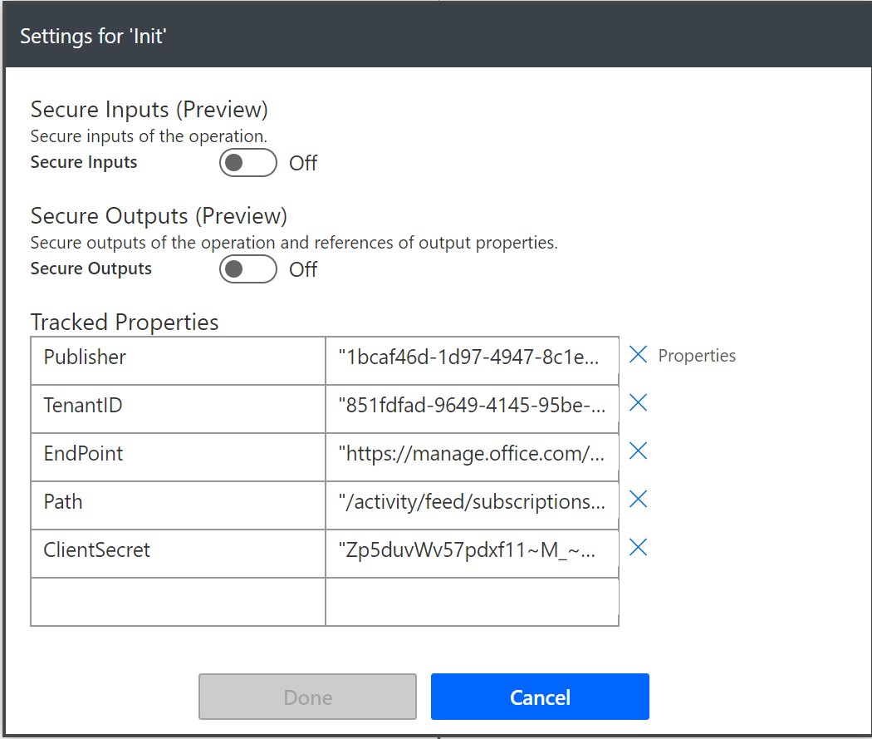
For all other Flows in the Solution, look for the “Init” activity and go to the Settings card and paste in Client ID under the “Publisher” property. Update the TenantID and ClientSecret values as well to match the one generated in the Azure AD App registration steps.

Slide 14
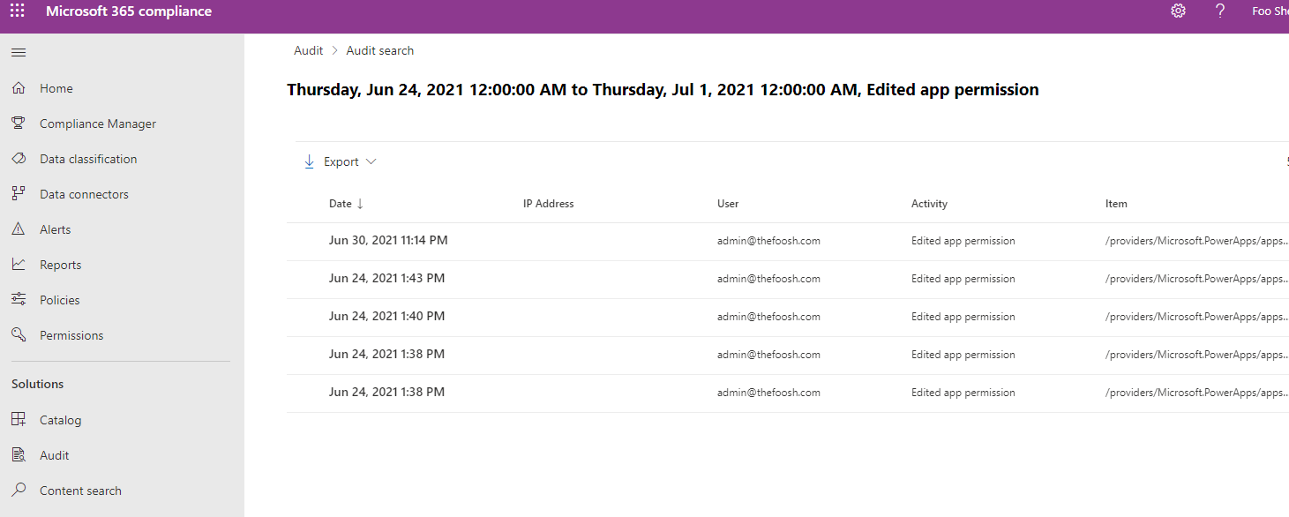
In Office 365 audit search, check to see if there already audit data coming through. You may need to wait especially if you have just turn it on within less than 24 hours.

